Slide 1
EMPATHIZE
We want to be able to correlate offset well with actual well.
This would help us to QC (quality control) our data

Slide 2
DEFINE
Objective:
To QC and deliver consistent and accurate data to clients (customers)
Decision:
This would assist in decision making based on QC result if operation should continue or not.
Challenges:
How to put the offset well and main together
How to interpret or process data using Machine Learning.
How to push it to predix to get an App.

Slide 3
IDEATE
Ideas on how to realize this project ?

Slide 4
IDEATE

Slide 5
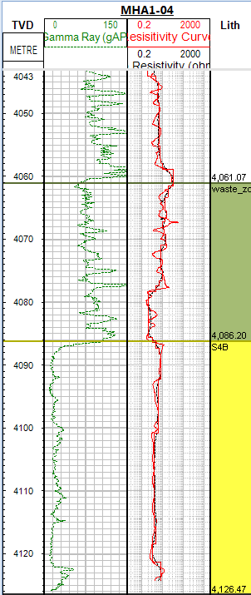
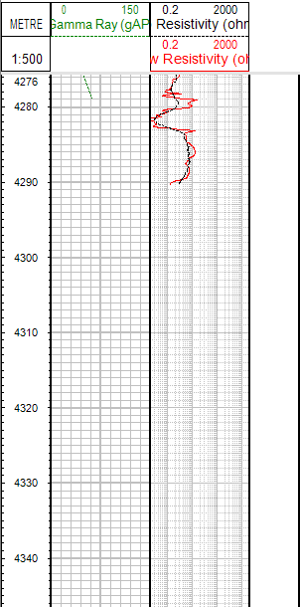
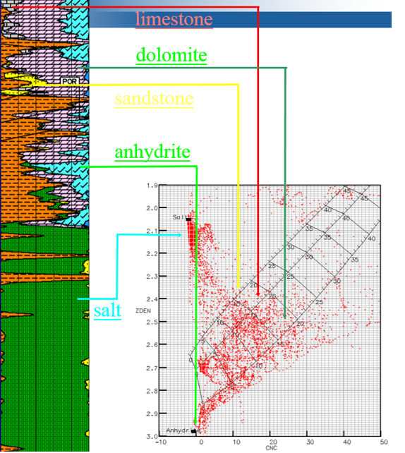
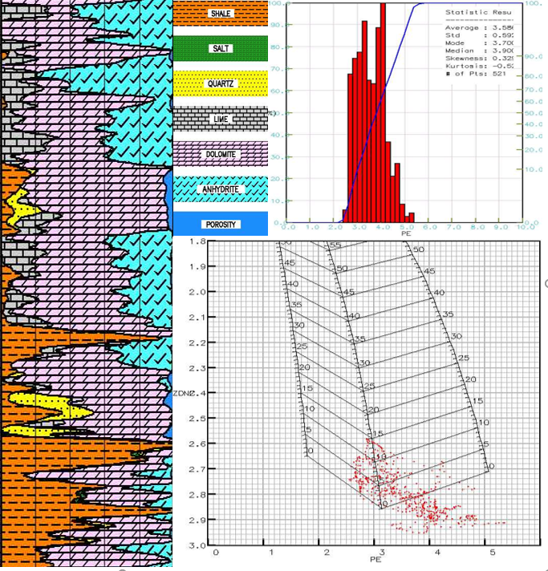
SCOPE

Slide 6
Step for project
Step 1 : load data (offset)
Step 2 : create database and setup the main(streaming)
Step 3: Log QC
1- well-to-well correlation based on the GR (to check if actual data is similar to the offset well.
2- plot RT vs Memory logs and confirm if all curves are matching.
3-check if all logs are reacting to the formation.

Slide 7
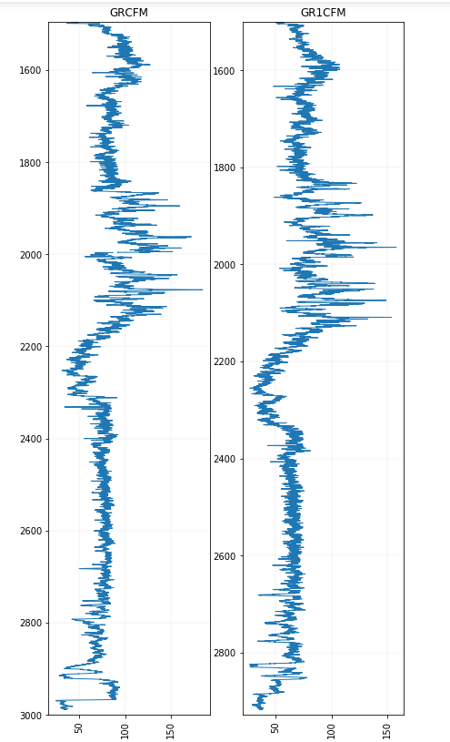
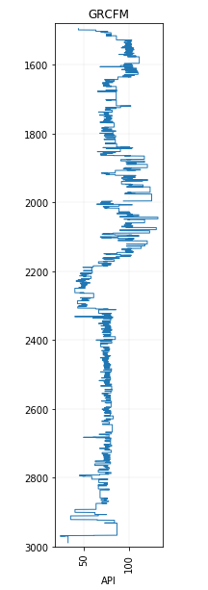
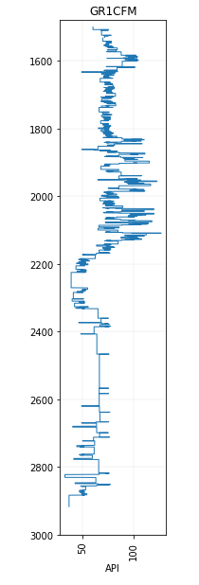
Fig1: non segmented GR
Fig 2 : segmented GR showing beddings

Slide 8
PROTOTYPE

Slide 9
TEST

